Slide 1
E-Commerce Project
Group 1:
Aryan Rana Tulika Jain
Gaurangi Pradhan Lokesh Potala
Gauri Kulkarni Shubh Agrawal

Slide 2
Presentation Content
Brief of our Case Study
Deployment through Docker Using EC2 Instance
Deployment Through Kubernetes Cluster Using EKS

Slide 3
Brief of our Case Study
E-Commerce has become the lifeline of economy today. Ecommerce sites hold 22% of world trade. An ecommerce application should provides users with lot of options not just in terms of products but also, other operations, like payment, delivery. Also preferences related to product purchase can be beneficial to organisations involved in trade to identify different trends related to products.

Slide 4
Deployment Through Docker Using EC2 Instance
Connect through a running ec2 instance and install docker:
Create a folder “E-commerce-project” and clone your project’s jar file:
Create two files ‘Dockerfile’ for running the image and ‘docker-compose.yml’ for building the image of the jar and database for the project:

Slide 5
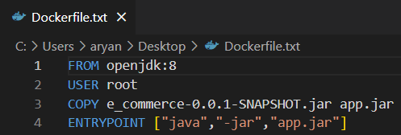
Dockerfile

Slide 6
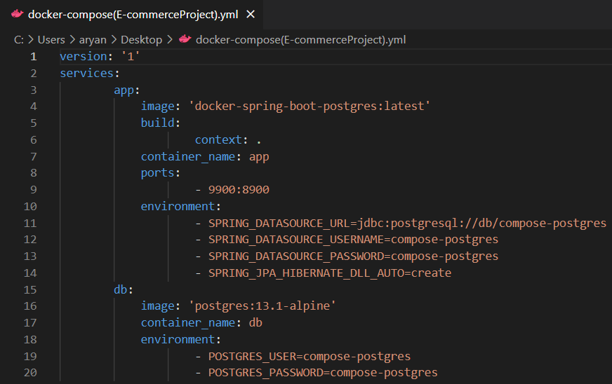
docker-compose.yml

Slide 7
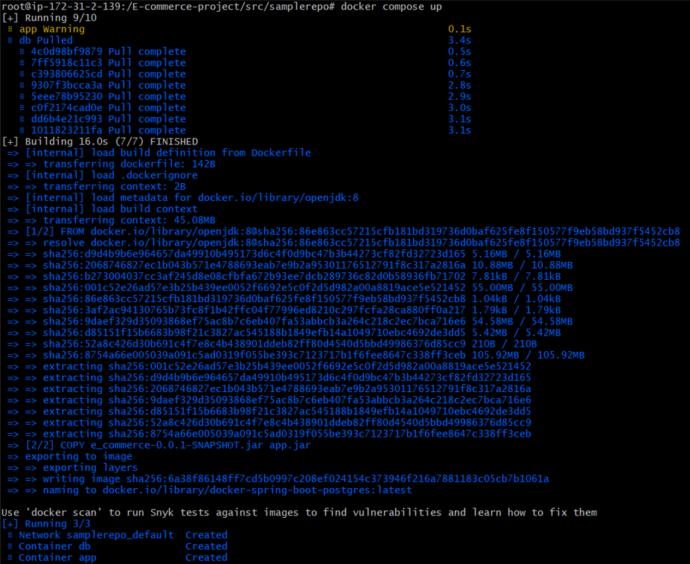
4. Run the command for to build and run the project:

Slide 8
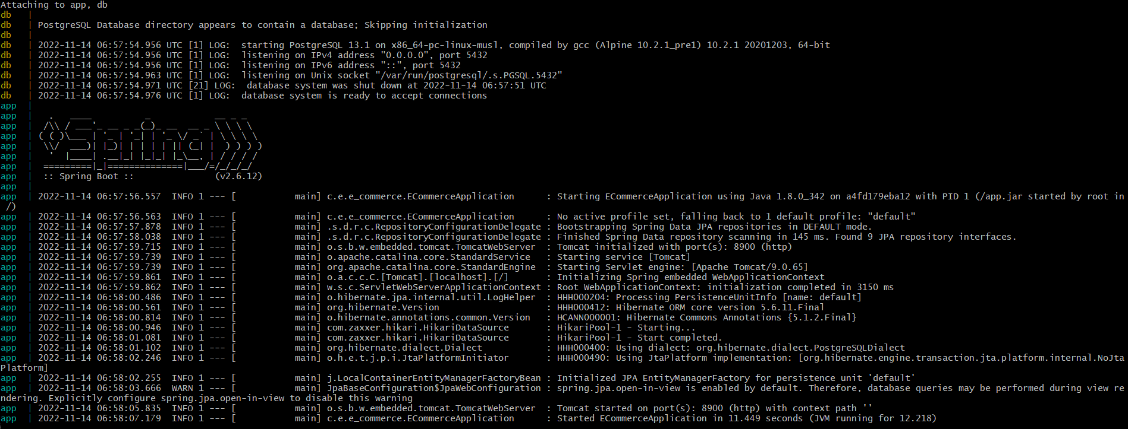
5. Your project is in running state now and you can check in browser through the public ip address of your ec2 instance:

Slide 9
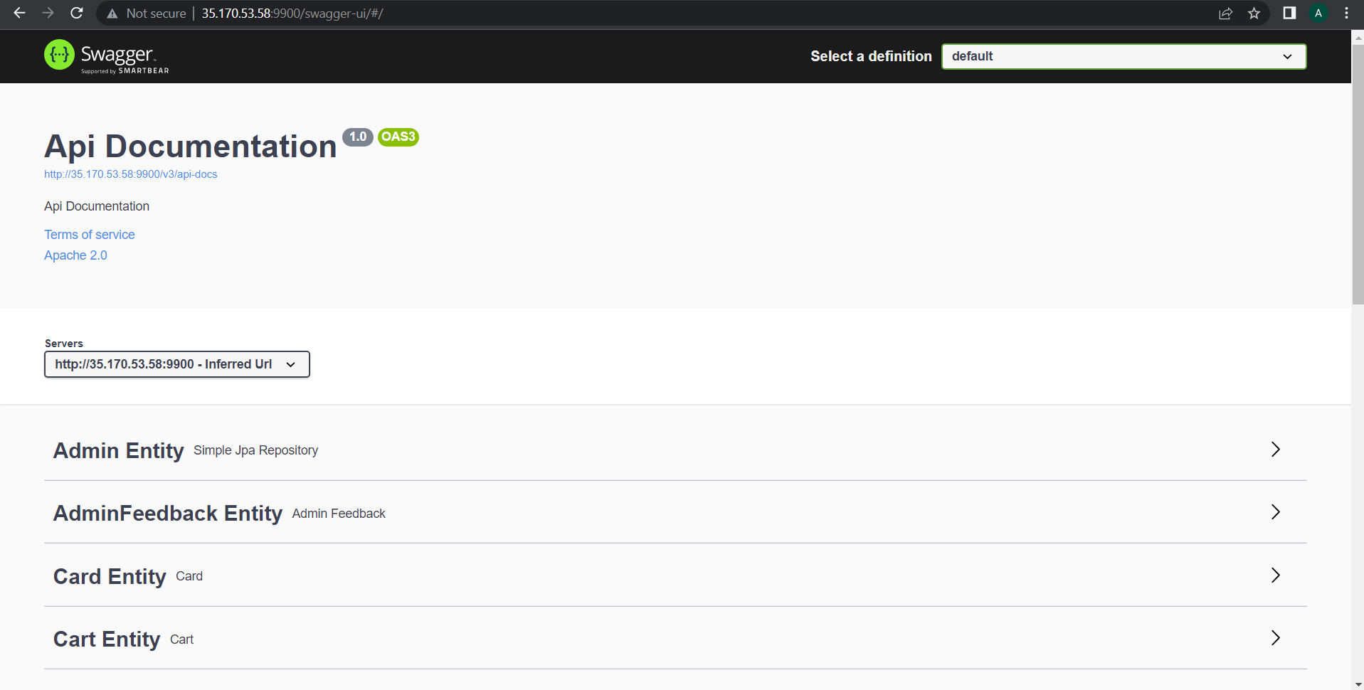

Slide 10

Deployment Through Kubernetes Cluster
Using EKS
Configure your AWS credentials in the ec2 instance:
Download kubectl and eksctl:

Slide 11
3. Create a cluster using eksctl command:
4. Check if Cluster is created or not:

Slide 12
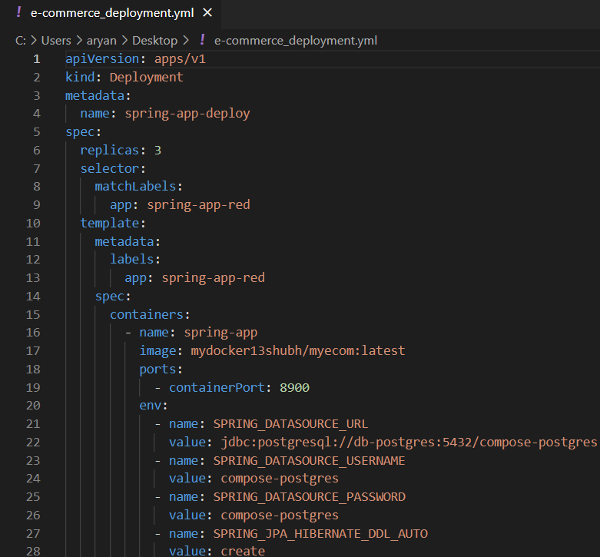
5. Create a manifest file for deployment of apps:

Slide 13
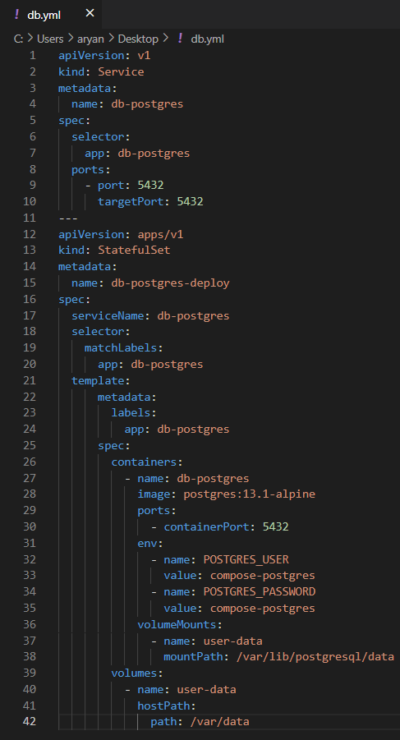
6. Create a manifest file for Database:

Slide 14
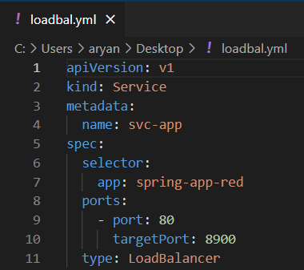
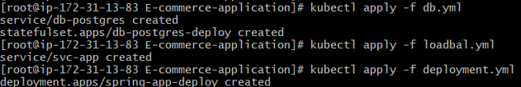
7. Create a manifest file for Load-Balancer:
8. Apply all the manifest files using kubectl:

Slide 15

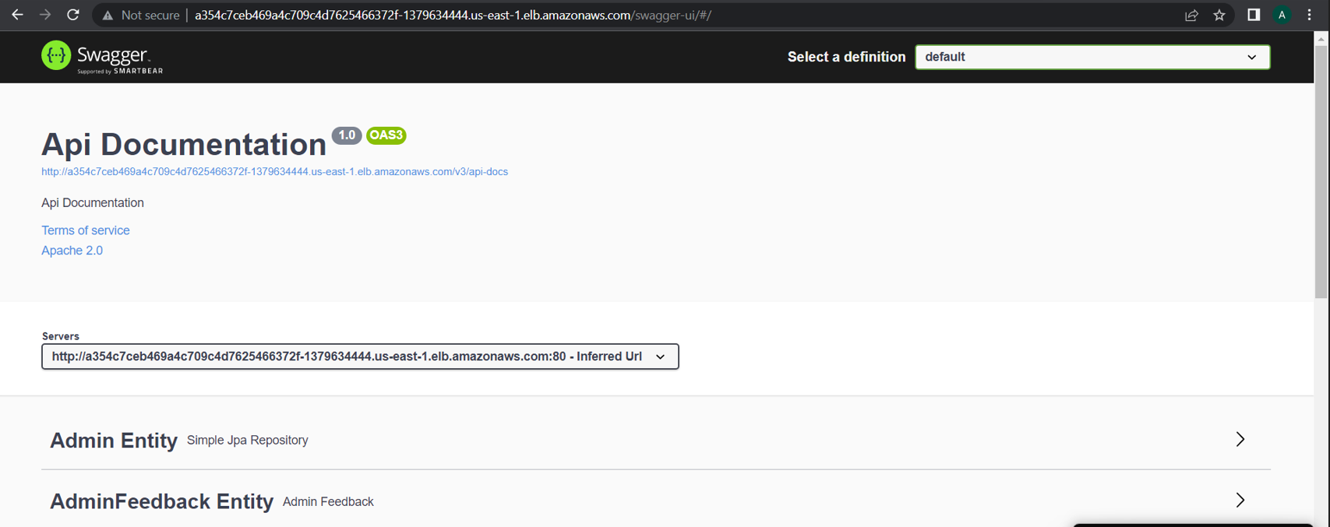
9. You can see that all pods have been created and are in a running state:
10. Connect to your app through Web Browser:

Slide 16


